Slide 1
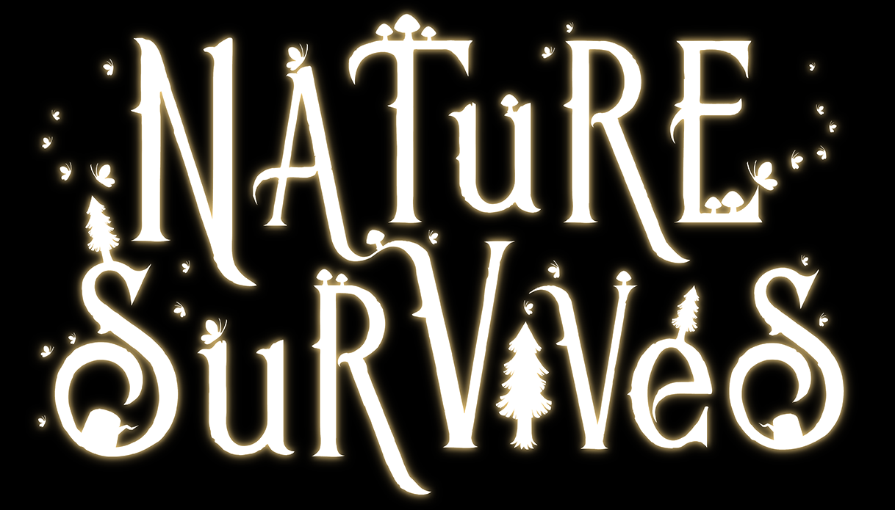
CREATIVE DESIGN DOCUMENT
Throwaway

Slide 2
Art Direction Overview
· Art Style
Fantasy & Cartoonish style
The art style has a flavour of its own, but takes significant inspiration moving forwards from the Spyro: Reignited Trilogy. The cartoon style begins to favour more vibrant coloration across all the visual aspects of the game, without making the various creatures and buildings that inhabit it appear flat. Much like the new Spyro games, we are working to combine vibrant coloration with depth and an appealing sense of shape.
· Theme & Setting
In Nature Survives, we want to convey a world that is deeply stylized, yet accessible. A game that holds strong visual appeal through its vibrant colors and unique inhabitants, whilst effectively communicating information and enhancing the game experience.

Slide 3
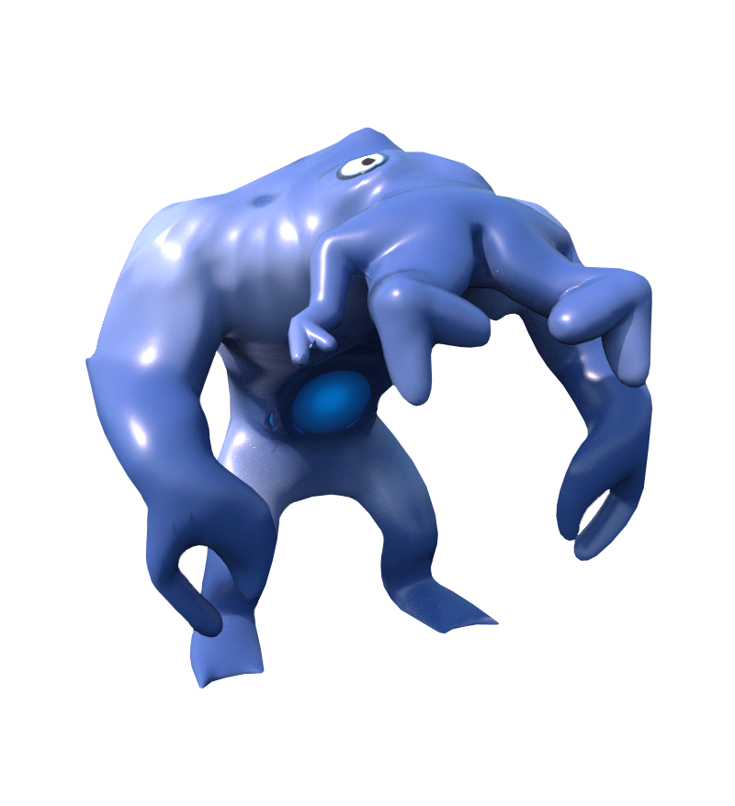
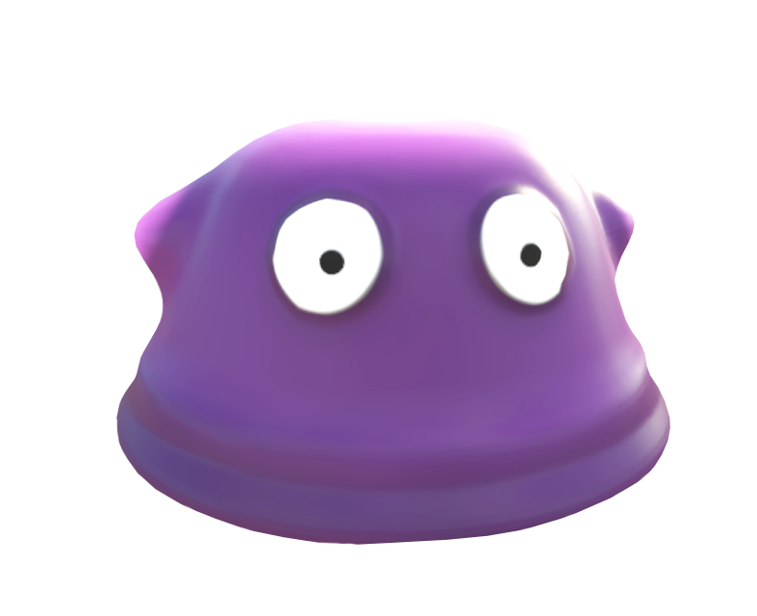
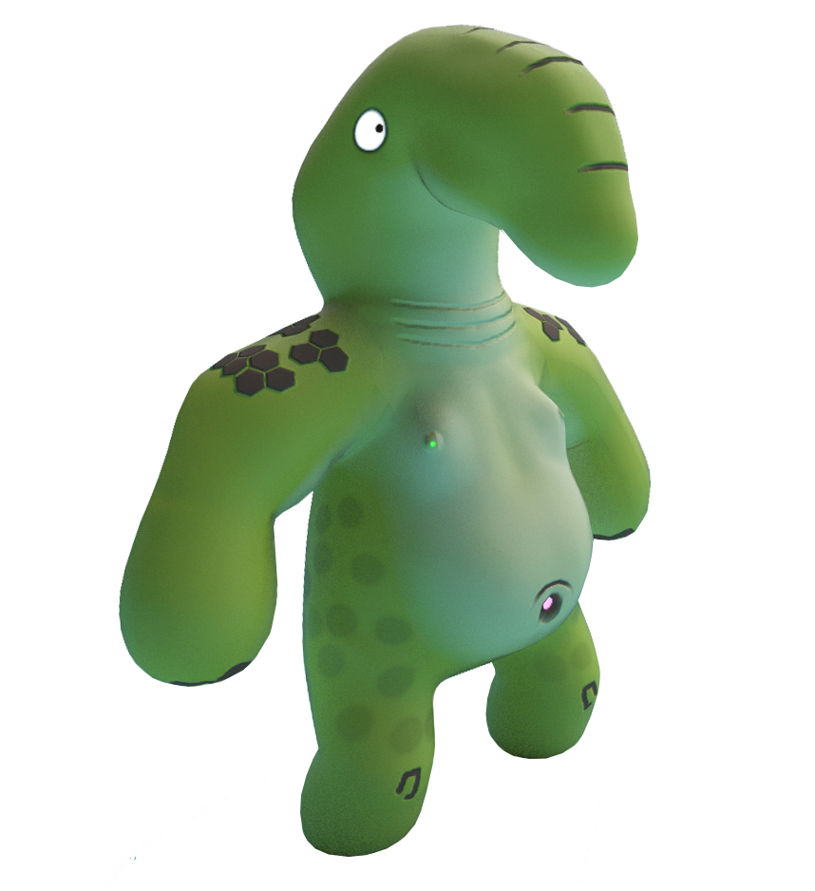
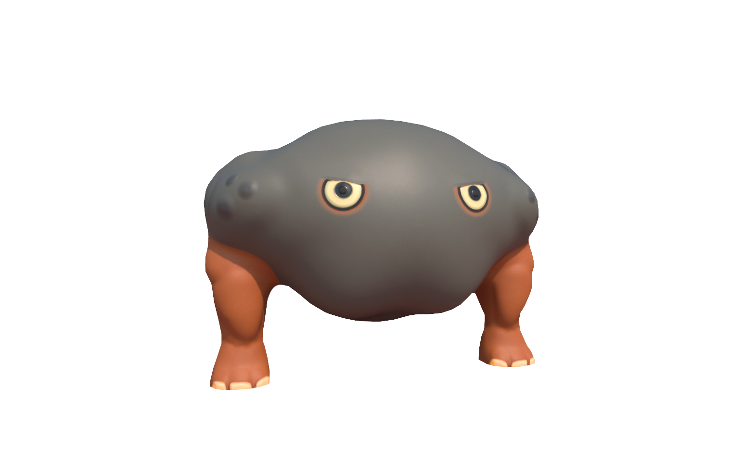
Strengths
· Daytime Scene & Nighttime Scene
· Clear silhouettes
· Environment concept art
Weaknesses
· Communication

Slide 4
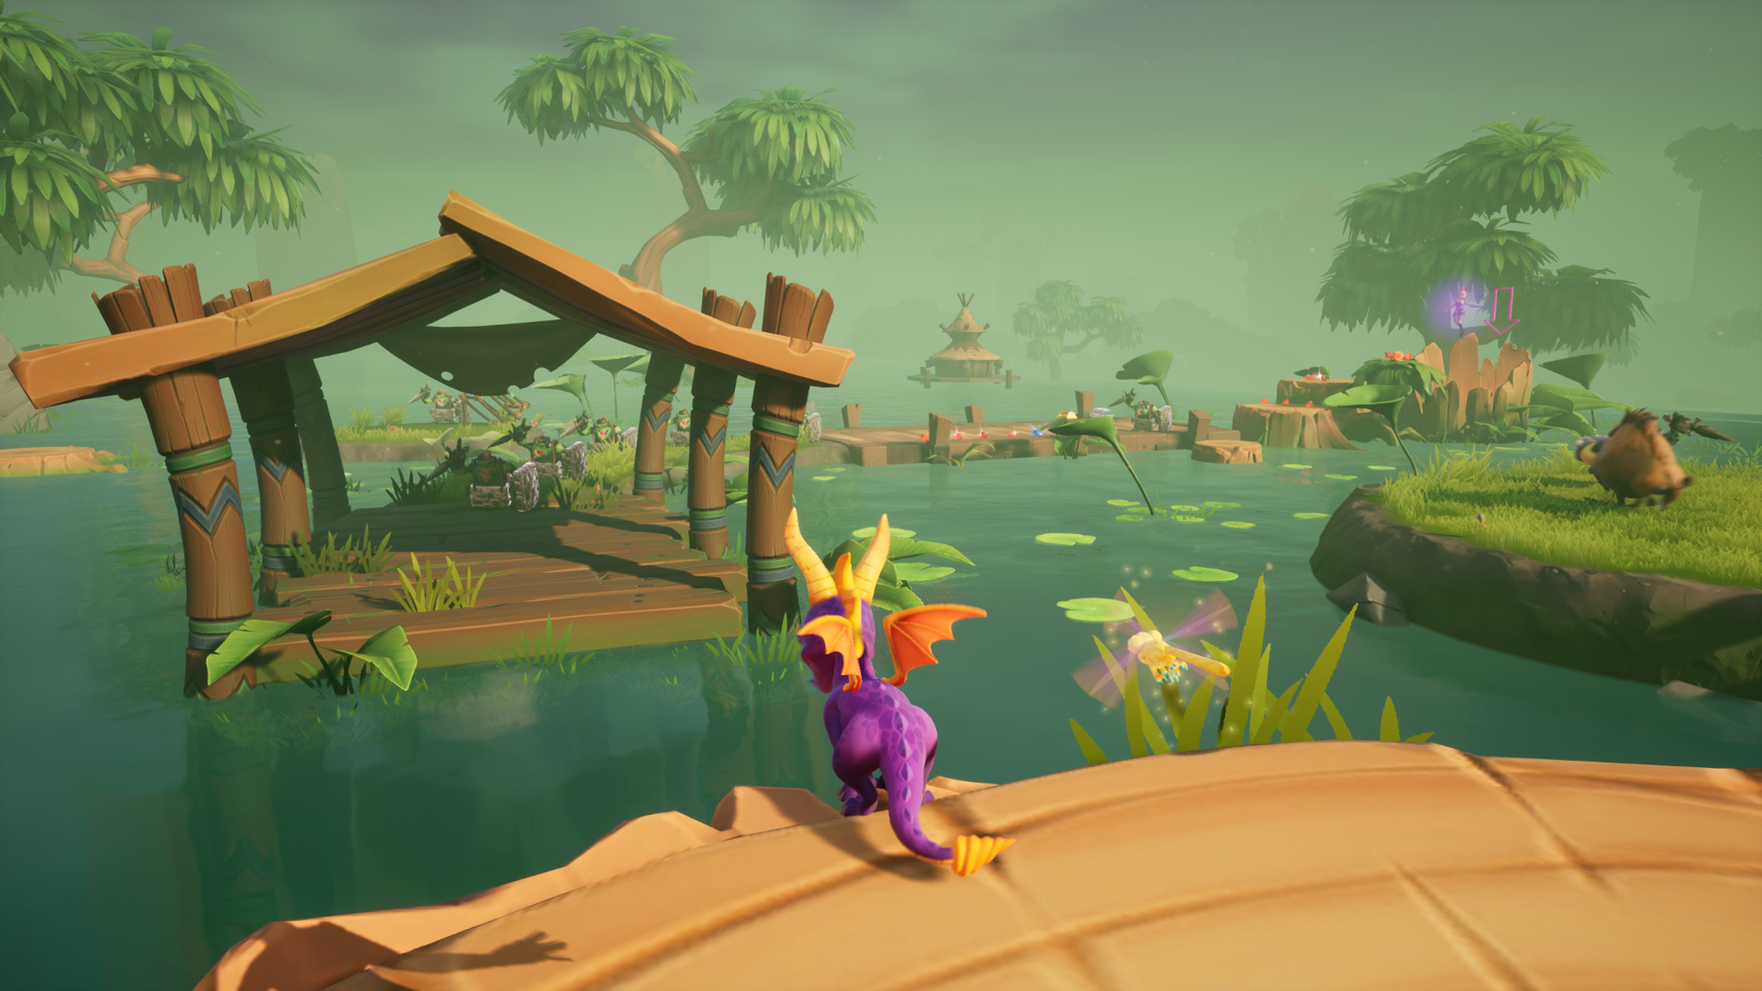
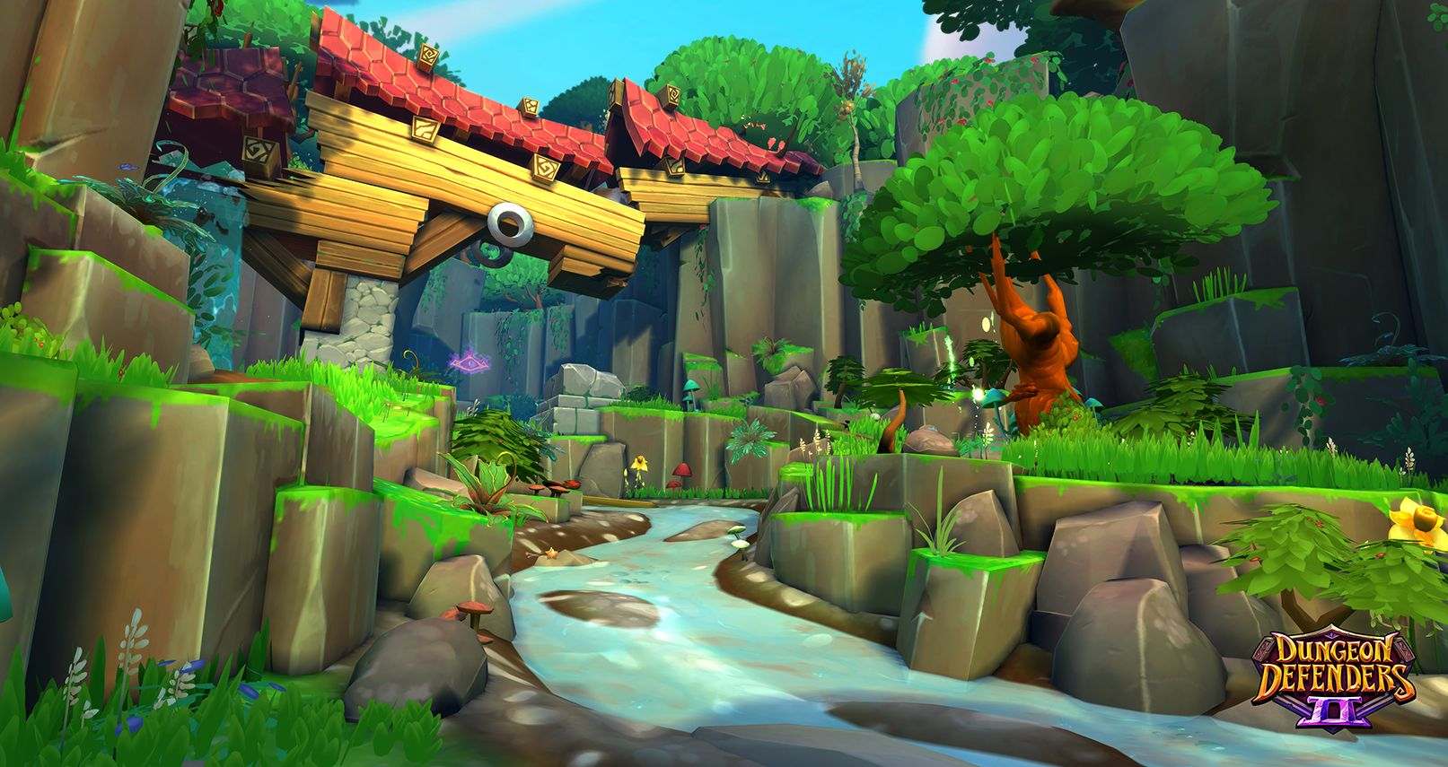
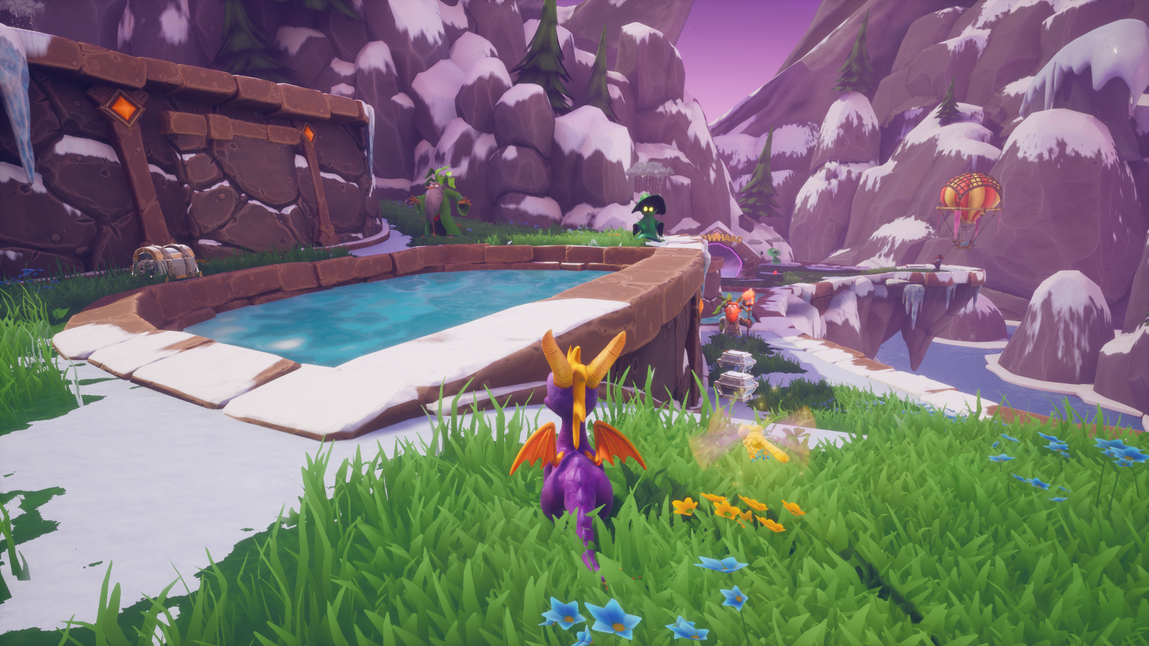
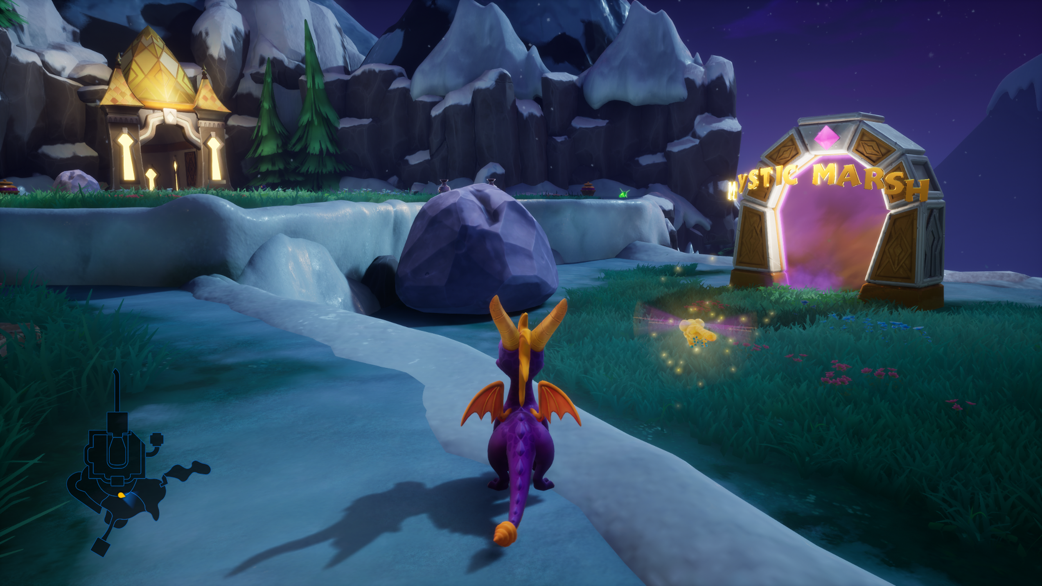
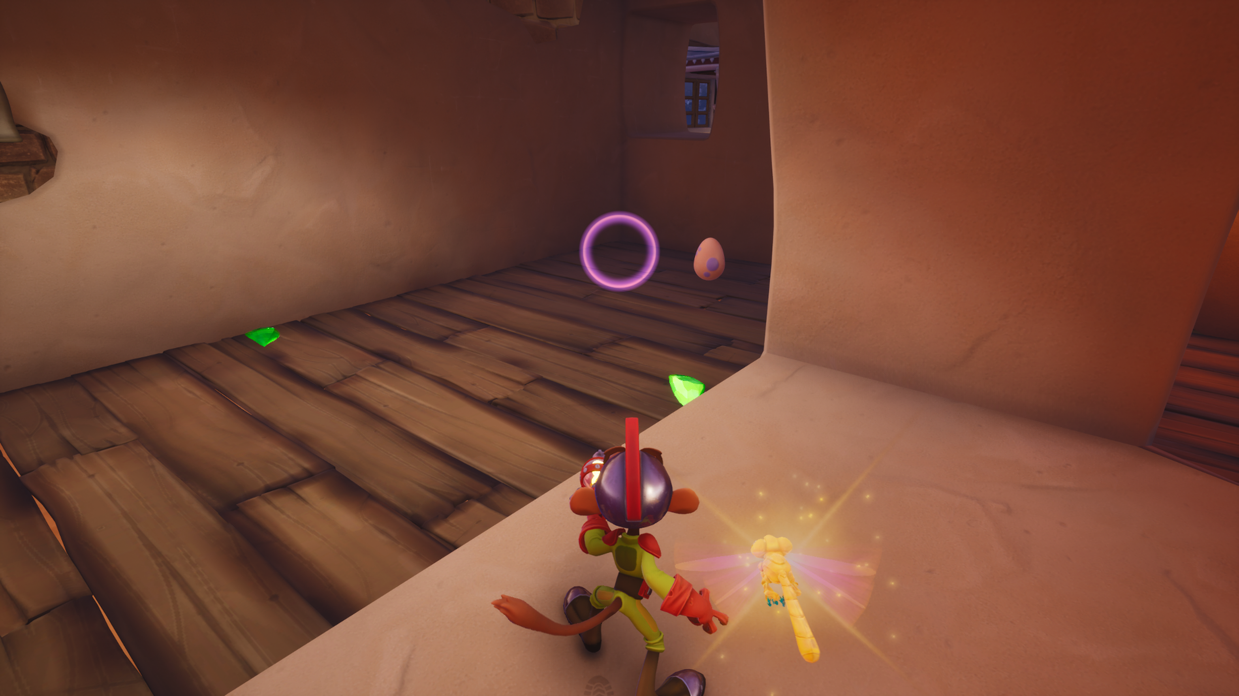
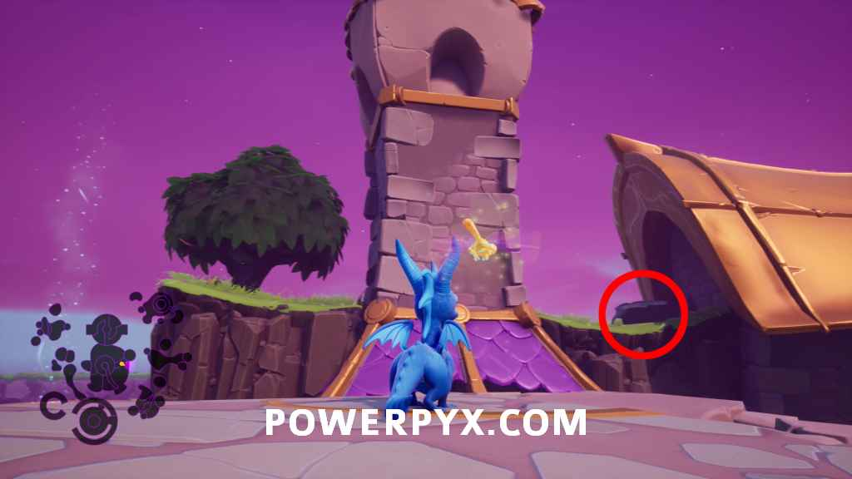
General Moodboard [Overall Feel of the game]

Slide 5
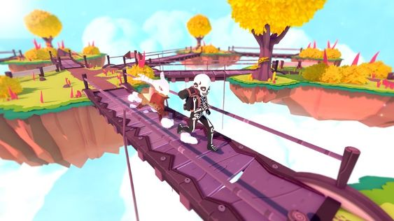
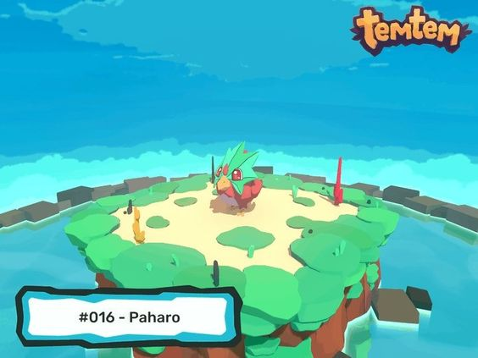
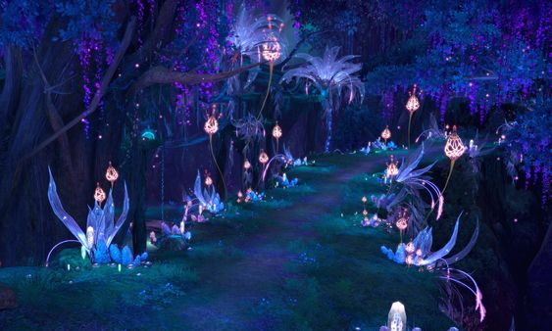
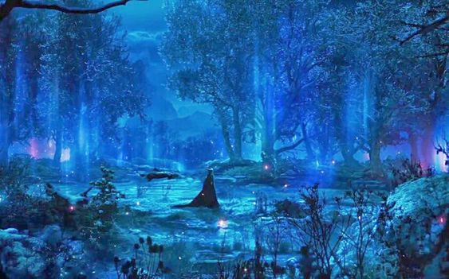
Environment Art Direction

Slide 6
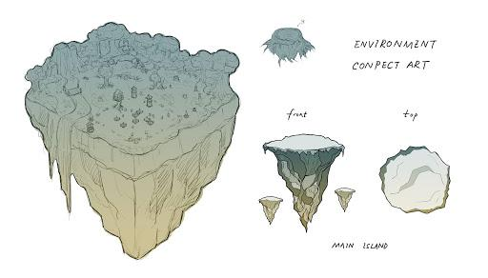
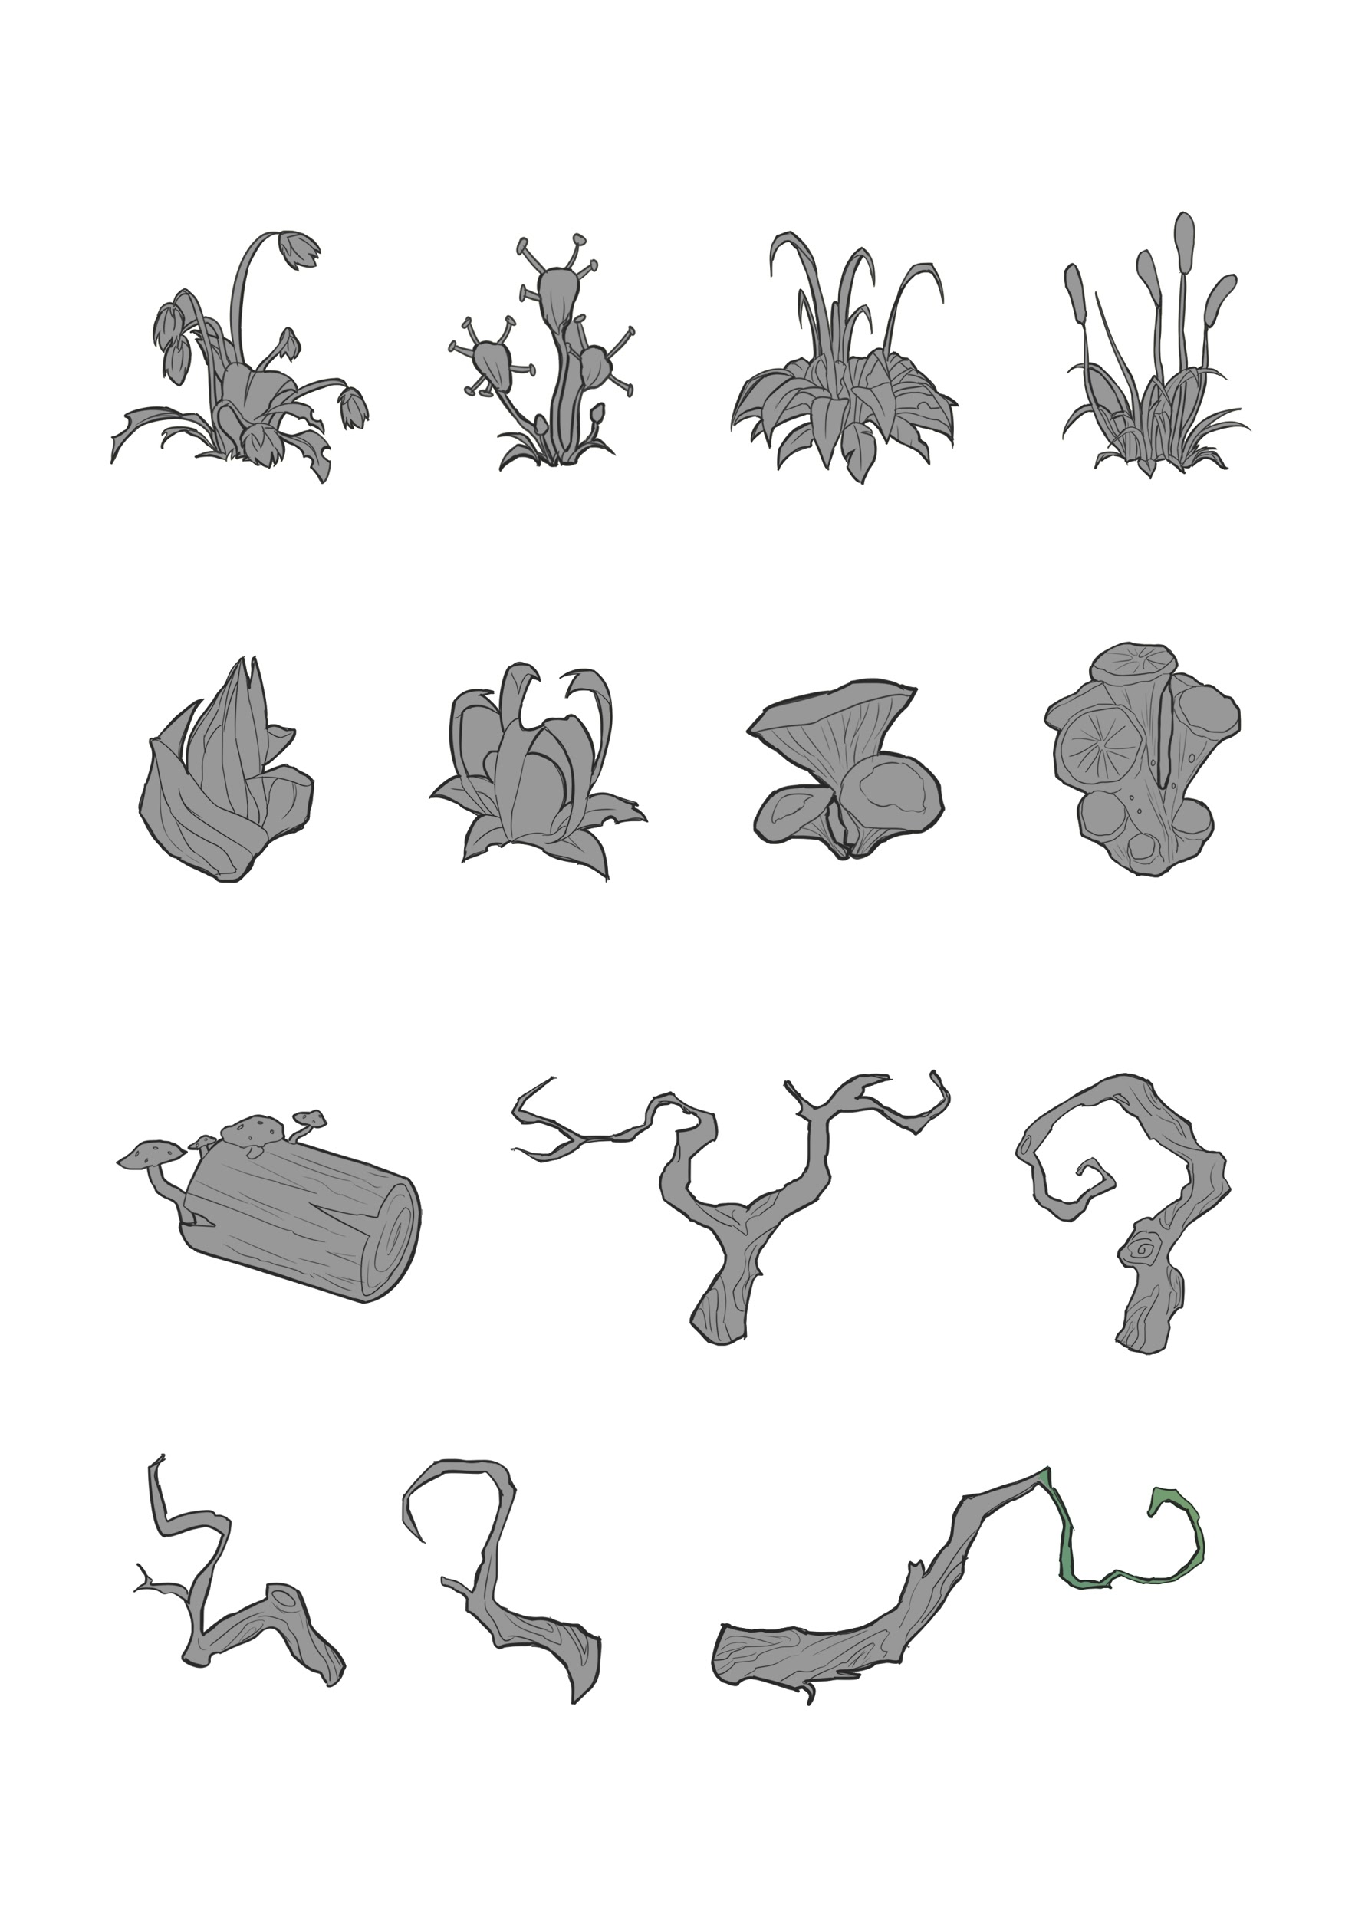
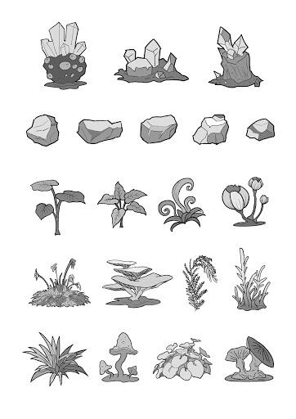
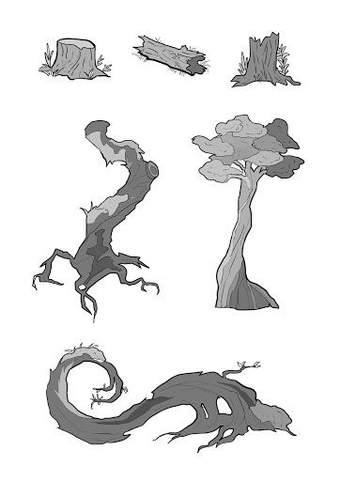
The Concept Art
· Floating Island
· New plants, rocks, trees
· New environment

Slide 7
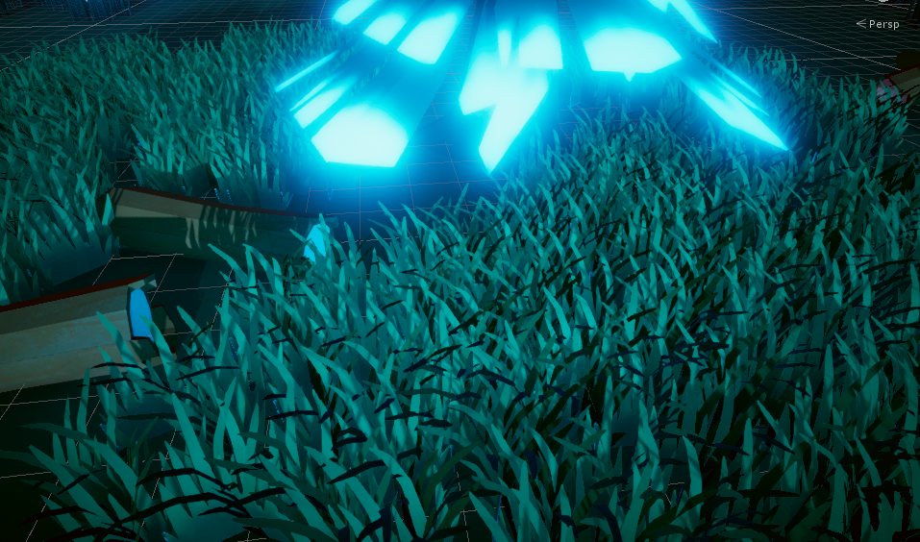
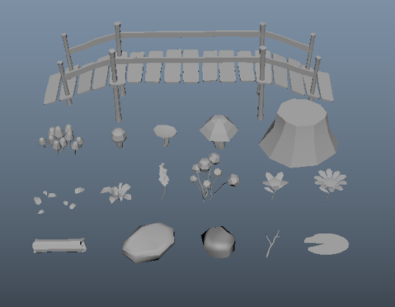
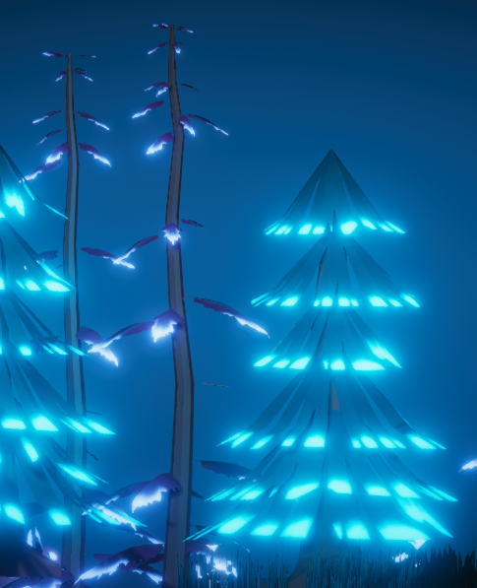
Environment Assets Design
· Plant
· Tree
· Rock
· Grass
· Mushroom
· Wood
· Floating Island

Slide 8
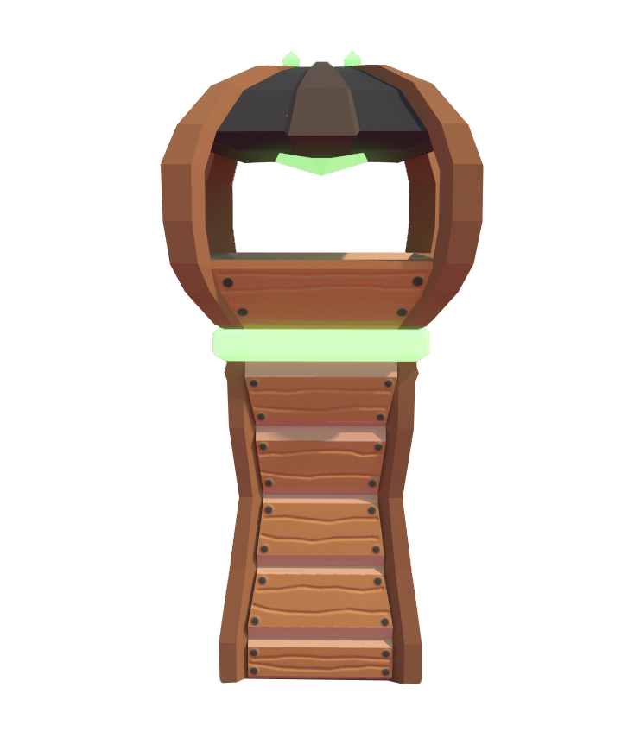
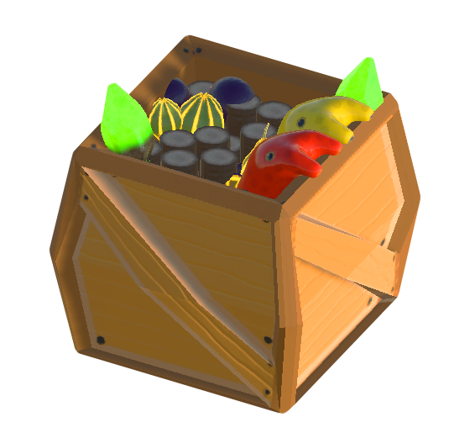
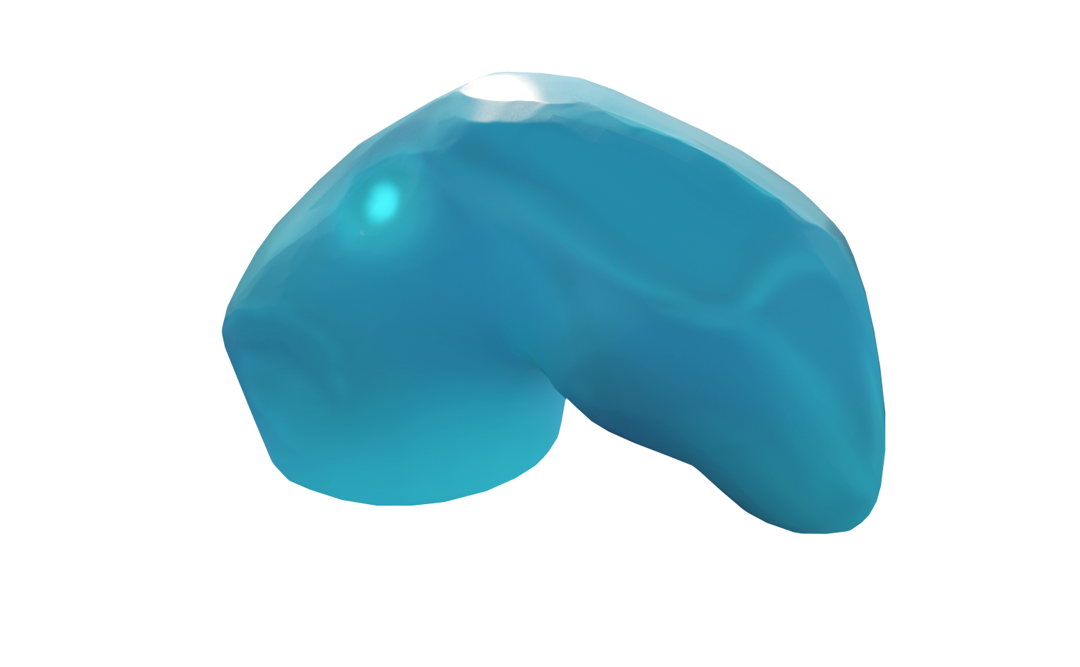
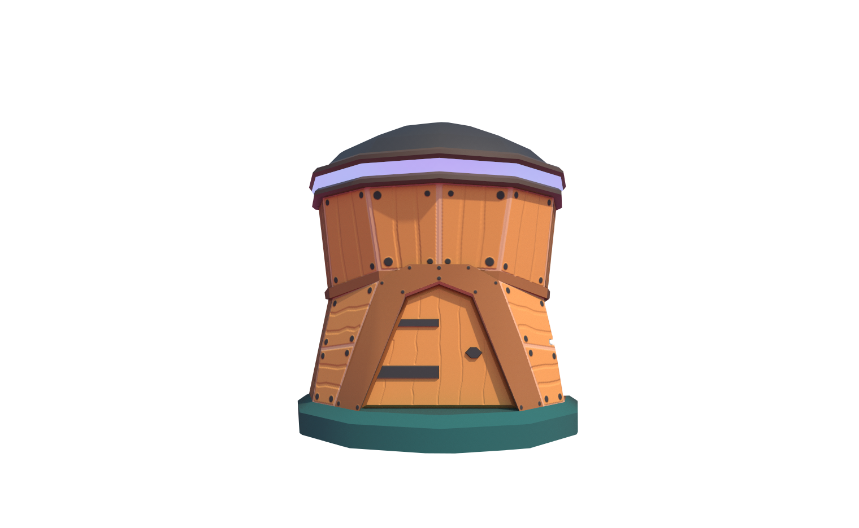
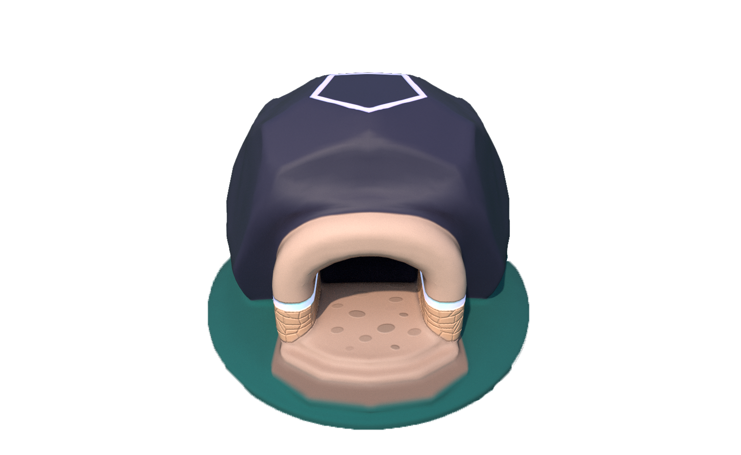
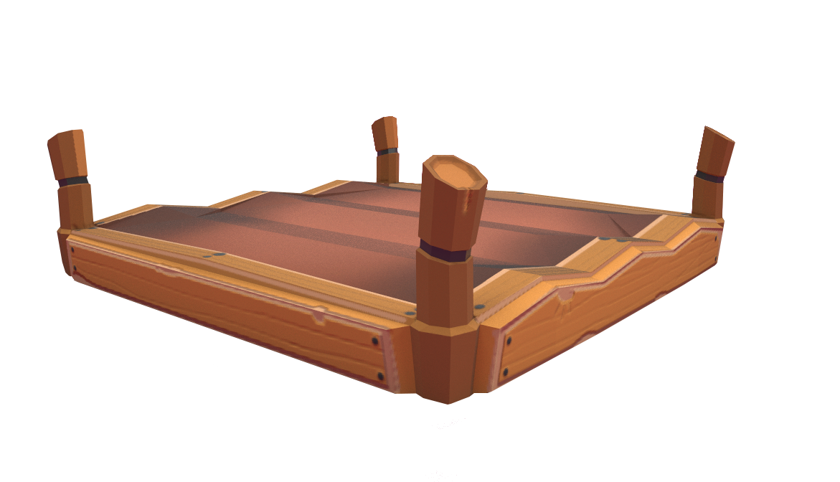
Building Redesign
· House
· Main Base
· Farm
· Wonder
· Tower
· Storage
· Scaffolding

Slide 9
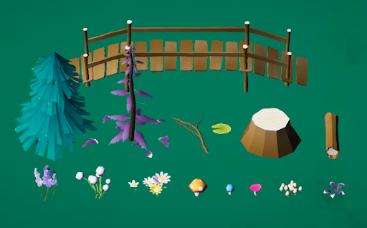
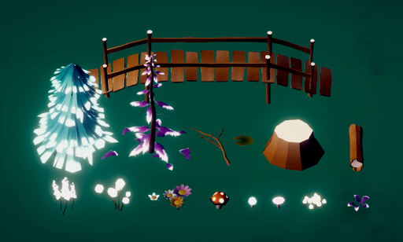
Textures & Materials
· Emissive maps for the nighttime scene.
· Daytime
· Nighttime

Slide 10
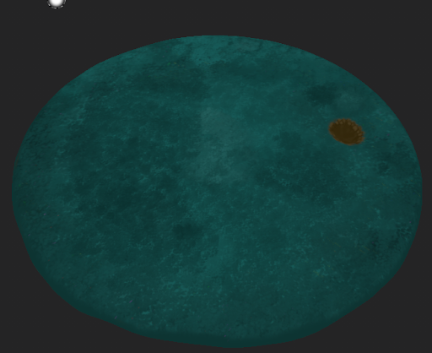
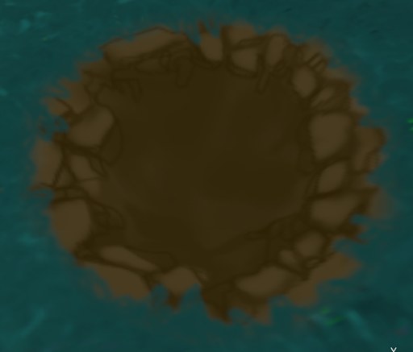
Textures & Materials
· New ground texture
· Hand painted style

Slide 11
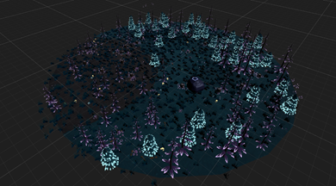
Game Environment Design
· New game environment layout
In order to clearly distinguish between different areas, different kinds of plants will only appear in one area. The objects of the corruption biome environmental props can be similar to other areas, however the objects need to be seen as corrupted. The corruption biome area represents dead.

Slide 12
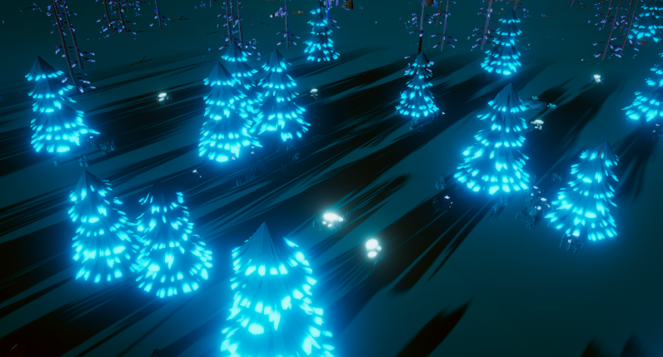
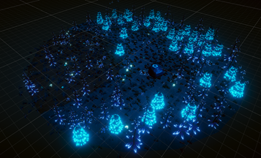
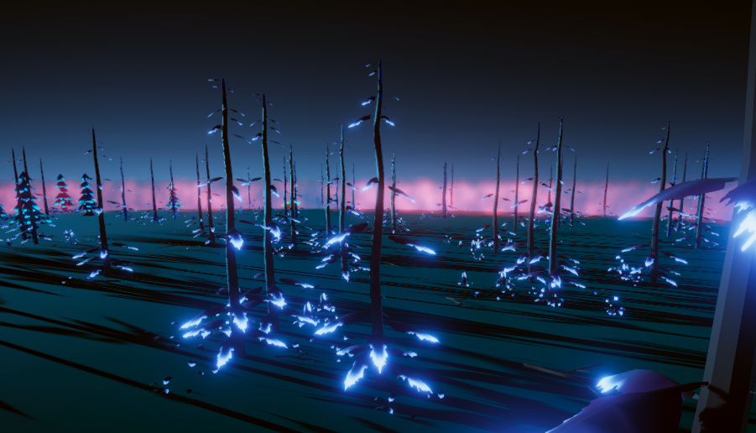
Game Environment Design
· Add ambient lights
· New plants
· New layout

Slide 13
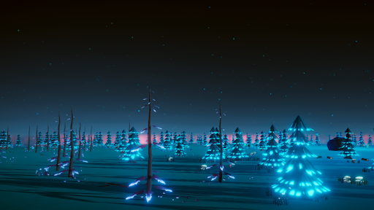
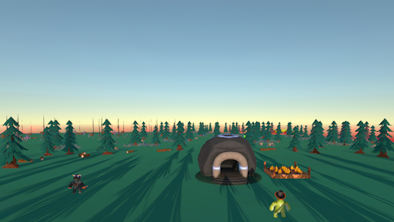
Ambient Lights
· Post processing volume
· Point light
· Daytime
· Nighttime

Slide 14
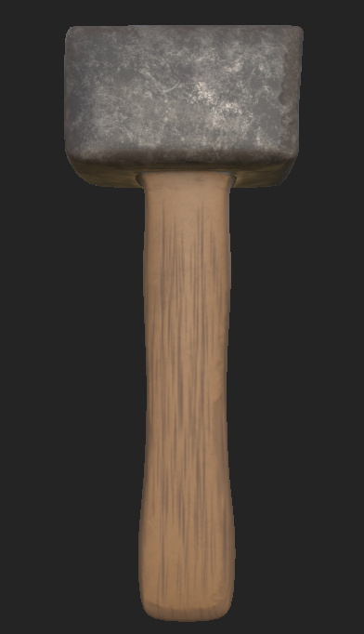
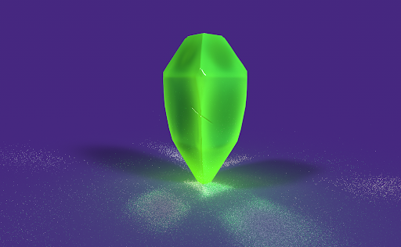
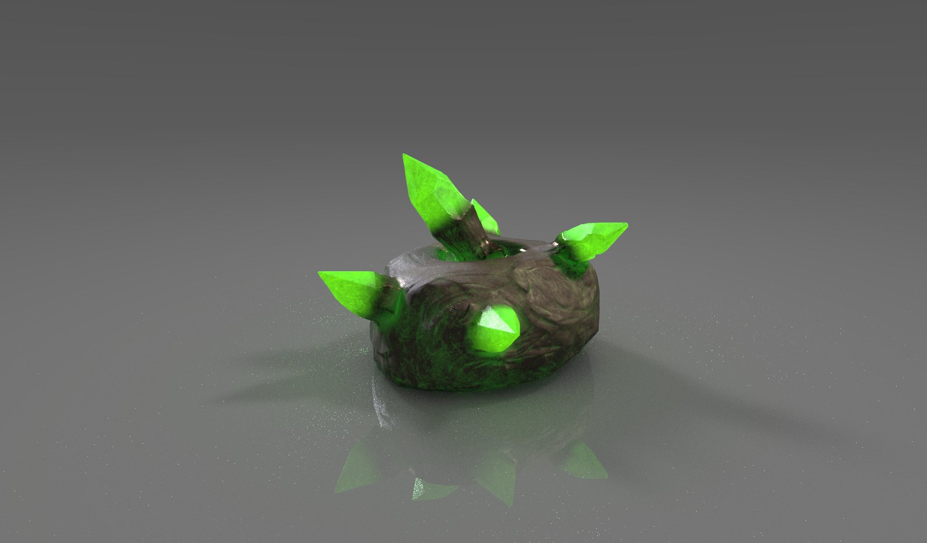
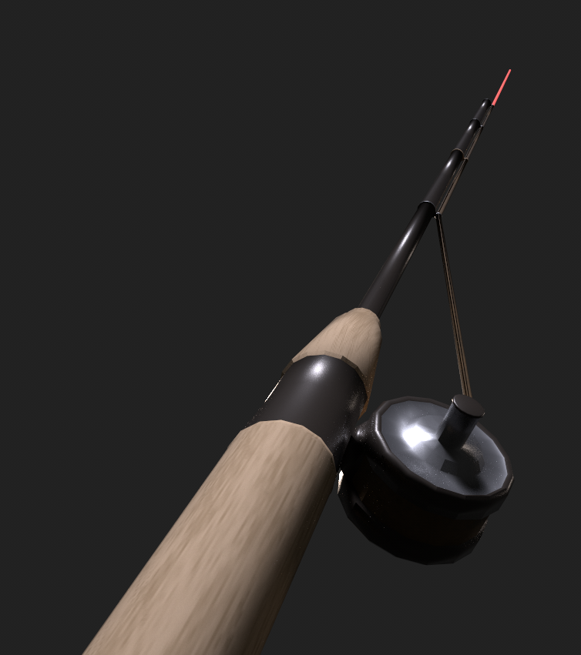
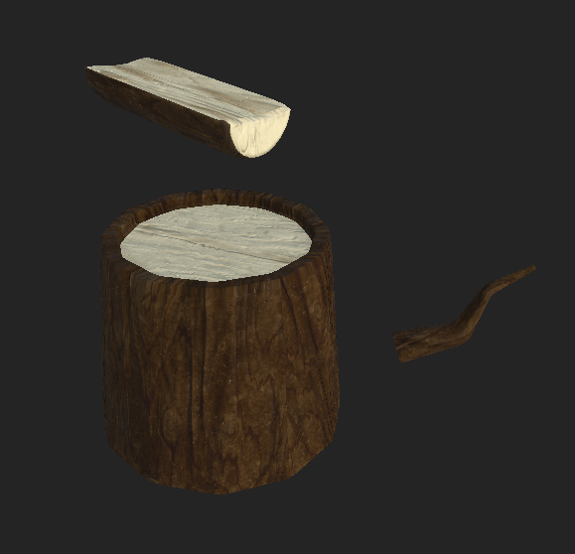
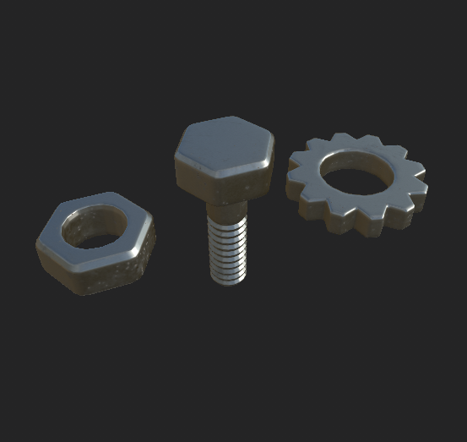
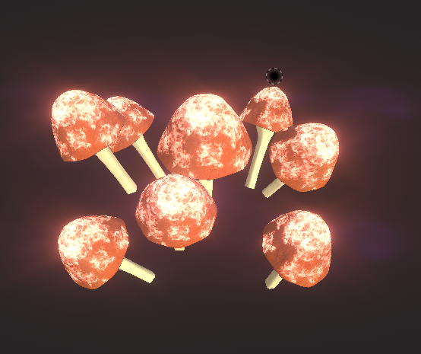
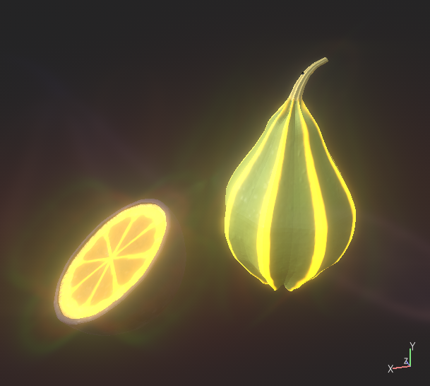
Resource Assets Design
Wongles can be sent to collect resources
· Wood
· Metal
· Mushroom
· Food
· Geiger Strain (From crystal nodes)
· Hammer
· Fishing Rod

Slide 15
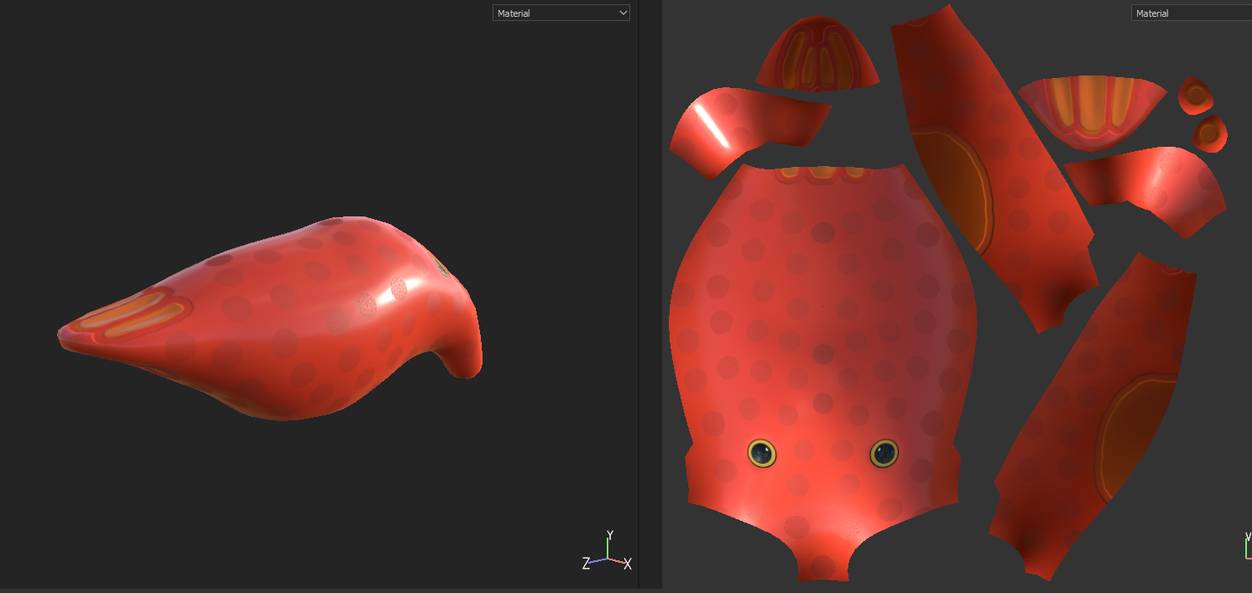
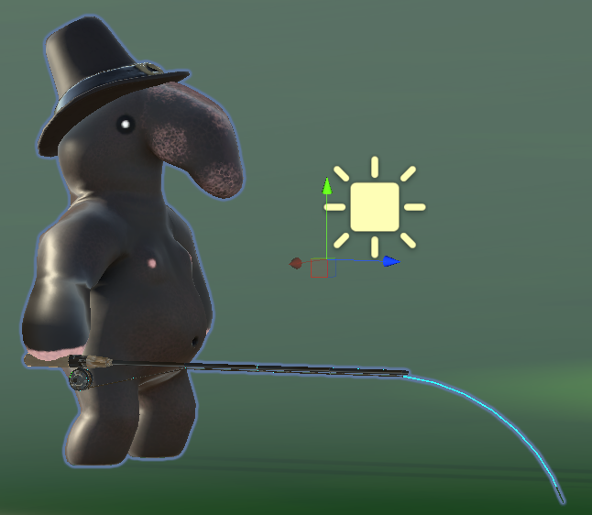
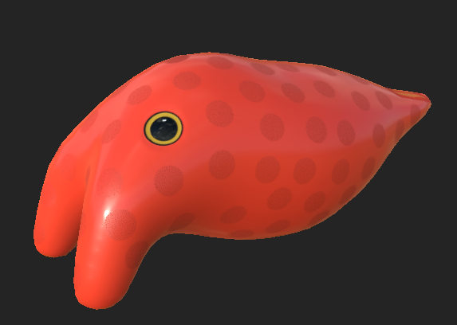
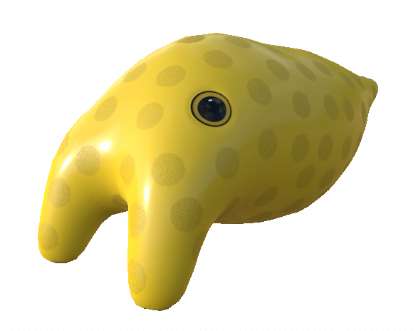
Fishing Object Design
A creature that can be pulled out of the water and carried back to base, representing collected food via fishing.

Slide 16





Tool/Hat Design
Created to represent different roles/tasks between units
· Woodcutting
· Mining
· Farming (Gathering)
· Patrolling
· Attacking (Melee/Ranged)
· Evidence of the research/upgrade system
· Emission/Silhouette helps distinguish units/tasks at night
· Fishing Hat

Slide 17





Character Moodboard Reference

Slide 18
Characters Design
The Wongles are the main player units. They are a colony of weird looking humanoid creatures with big noses. They act as workers. The workers can do many tasks such as mining, chopping wood and farming. The Scrungus and Wizak are both military units that specialize in the defense of the base and the offense against the corruption and its forces. The Scrungus specialize in melee combat and the Wizak in ranged. The Scrungus and Wizak are their own unique species and are not Wongles.
The Mushroom Friends are the forces of the corruption. They are humanoid mushroom based creatures that crawl across the ground with the sheer strength of their upper bodies. There are two types of Mushroom creatures, the Brood-Shrooms and the Fiends. The Brood-Shrooms are the elders/leaders of the corruption forces. The Fiends are the main grunt force of the corruption. They are quick and ferocious and lay waste to anything they come across, and they are spawned by the BroodShrooms which act like a mobile base for the enemy forces.
The Junger Slunk is a new enemy unit born from the Brood-Shroom but with a different purpose to the Mushroom Friends; this unit will fix itself to the ground at a safe distance and fire projectiles at the players base. They are shy however, and will be unwilling to attack your player units, preferring solidarity and to stay a safe distance away from combat.

Slide 19



Wongle Character Process
Designed to be cute, visually distinct to the game
· Unit variations expressed through tool usage/hats
· Original design inspired by psychedelic art
· Adapted to a fantasy setting
· New animations created for task variety

Slide 20


Wongle Character Process
· A new default texture for the Wongle Worker.
This task features the first batch of the art overhaul changes. Going forward each major art asset will receive new textures more closely affiliated with our new moodboard, heavily consisting of reference to the Spyro Remastered Trilogy.

Slide 21




Mushroom Character Process
Designed to be hulking, visually intimidating compared to wongles
· Created to overwhelm defenses
· Mushroom design inspired by psychedelic art
· Theme of nature adapted around these creatures
· New unit; The Broodshroom created as a mobile spawn point

Slide 22




Warrior Unit Process
· Deadly War Scrungus
· Deep One
While the skin changes did make a difference, players were still confused by the fact that wongle units didn't all share the capacity to work on resource farming. Players would often have a warrior selected, and become confused when they wouldn't mine a crystal, or work on a farm.
In creating a new model/animation for the warriors, we can very clearly distinguish the warrior units from the workers, and hopefully resolve the issue of players confusing their functions.

Slide 23



Enemy Unit Process
· The Junger Slunk
This unit is being developed from the tutor feedback that our enemies need more combative depth, in order to expand the complexity of the combat phases to a reasonable extent, giving players a broader range of considerations when they defend their base.
The Junger Slunk will attack buildings from a distance, making bases more vulnerable, but it will not attack player units.

Slide 24







Menu Design
Menu Reference
Old
New
· Fantasy feeling
· Metal material
· Option button should be really clear
· Altered camera position
· Featured updated art
· Post processing

Slide 25


UI Design
Old
New
Redesigned for aesthetic unity and visual clarity
Color choice
· Metal color
· Transparent background
Art style
· Fantasy
· Fit the vein of Alice in Wonderland
Refer to the game Driftland's UI layout.
Used the transparent effect, so that the UI can be suitable for daytime and nighttime both ambient lights.

Slide 26



UI Design
· Main menu
· Settings menu
· Help menu
· In-game UI
· End screen

Slide 27








Icons & Buttons Design
Design choice
· Metal color
· Gradient background
· Transparent
· Inner/outer bevel
All new cursors which changing states based on in-game interactions

Slide 28

Minimap Icons Design
Developed a series of minimap icons to represent key resources, and player/enemy units.
Before there were simply a series of large squares that did a poor job of communicating the number of units a player had, and did not clearly highlight mining points of interest, nor distinguish different units (including the enemy) from one another.
These icons are a first pass at improving this.

Slide 29







VFX Design (Particles Effects)
Cartoonish style
· Fire & Smoke
· Wood chips
· Placed building
· Building attack & explosion
· Magic attack
· Foraging effect
· Leaf burst

